Slide 1
Spiritual Leaders
Deacon Paul Muller
Lee’s Summit, MO
(Kansas City)
Pastor Dan Woodward
Dwight, IL
Pastor Steve Kihlthau
Stockton, CA
Pastor Paul Abner
Crystal City, OK (Tulsa)
Deacon Luis Trevino
Schaumburg, IL

Slide 2
Paul Muller
Permanent Deacon in in the Catholic Church
Serves as the Director of the Permanent Diaconate for the Diocese of Kansas City St. Joseph
Ministers at St. Margaret of Scotland Catholic Church in Lee’s Summit, MO
Appointed Chaplain/Adviser of Carnival community in the USA by United States Conference of Catholic Bishops’ (USCCB) Subcommittee on Pastoral Care of Migrants, Refugees and Travelers (PCMRT),
28 years working with Carnival’s and the Outdoor Amusement Industry
Paul Muller
paul@oafinance.net

Slide 3
Paul Muller Full Bio
Paul is a Permanent Deacon in the Roman Catholic Church. Paul was ordained in June of 2009, after 4 ½ years of formation at Conception Seminary College. Presently he is the Director of the Permanent Diaconate for the Diocese of Kansas City – St. Joseph. In that role he is responsible for 74 Ordained Deacons, both active and retired who serve at parishes in the Diocese. Paul serves the needs of his local parish: St. Margaret of Scotland in Lee’s Summit, MO.
Paul and his wife Pam have been married for 48 years and have two children and 4 grandchildren. They live in Lee’s Summit, MO, a suburb of Kansas City, MO. Paul graduated from St. Joseph’s College, Rensselaer, IN with a BS in Management and a BA Communications.
For the last 28 years Paul has had the pleasure of being a part of the Outdoor Amusement, Industry. He is part owner of OA Finance, LLC, one of the companies who provide capital and equipment financing to Carnivals throughout the United States. During those 28 years he has had the opportunity to developed many long term friendships.
In January of 2021 he started his semi - retirement (3 days a week) with the thought of fully retiring in July 2021. His son Wade who is the President of OA Finance, LLC, will continue to serve the Outdoor Amusement Industry. Paul will help if needed at conventions and during the busy season.
This position allows Paul to serve the industry he loves in a different way.

Slide 4
Daniel L Woodward
Pastor of the First Baptist Church of Dwight, IL since 1983.
President of Dwight Baptist Academy (grades K5-12), our Christian school. It was through our school concessions fundraising events at festivals and fairs that I became associated and friends with members of the Showmen’s League.
President of WGVD 97.3 FM Radio, which is heard around the world in 190 different countries. I host the Saturday Morning Live program each week.
Director of the Midwest Christian Boys Football Camp, the Midwest Christian Ski Camp and the Midwest Christian Couples Retreat, ministries of First Baptist Church.
On the Advisory Board of Kyte River Revival Grounds in Rockford, IL, where I recently oversaw the building of their 1.5 million dollar dining hall.
I am the Concessions Manager at the Grundy County Speedway in Morris, IL.
I have been a professor at Providence Baptist College in Elgin, IL, for over 20 years.
Serves as Chaplain for the State of Illinois Prisons and the Grundy County Speedways and Fair
Daniel L Woodward
dlwoody@maxwire.net PH: 815.252.0691

Slide 5
Daniel L Woodward Full Bio
Born in 1957 in Wisconsin Rapids, WI (age 63)
Graduate of Mary D Bradford in Kenosha, WI
Graduated from Hyles-Anderson College with a Bachelor of Science
I received my Doctor of Divinity from Oklahoma Baptist College & Seminary
I have been the pastor of the First Baptist Church of Dwight, IL since 1983.
I am the President of Dwight Baptist Academy (grades K5-12), our Christian school. It was through our school concessions fundraising events at festivals and fairs that I became associated and friends with members of the Showmen’s League.
I am the President of WGVD 97.3 FM Radio, which is heard around the world in 190 different countries. I host the Saturday Morning Live program each week.
I am the Director of the Midwest Christian Boys Football Camp, the Midwest Christian Ski Camp and the Midwest Christian Couples Retreat, ministries of First Baptist Church.
I am on the Advisory Board of Kyte River Revival Grounds in Rockford, IL, where I recently oversaw the building of their 1.5 million dollar dining hall.
I am the Concessions Manager at the Grundy County Speedway in Morris, IL.
I have been a professor at Providence Baptist College in Elgin, IL, for over 20 years.
I serve as a Chaplain for the State of Illinois Prisons and the Grundy County Speedways and Fair

Slide 6
Steve Kihlthau
Organizes and plans the monthly Pastor’s Fellowship Meeting for Northern California
Serves as Chief Financial Officer for Golden State Association of Christian Schools
Serves on the Board of Pacific Baptist College in La Verne, CA.
Volunteer Chaplain for the Stockton Police Department
Currently a Captain of four other Chaplains and serves on the Board of the Stockton Police Chaplaincy as its President
Founding Pastor of Stockton Baptist Church
Currently the Superintendent if Stockton Baptist School and Noah’s Ark Preschool
Pastor Steve Kihlthau
pastor.sbchurch@gmail.com Stockton Baptist Church
209-931-6101 (Church)
209-969-5027 (Cell)

Slide 7
Steve Kihlthau Full Bio
Personal Background
Steve Kihlthau was born into the family of a Baptist pastor and has been involved in church from birth. Church life including Sunday school, church services and church planting are a valuable part of his earliest recollections of his childhood. He was saved at the age of six and called to preach at the age of twelve. Upon graduation from high school he spent fifteen years in the business world which included retail management and insurance sales and investments. Under his leadership, Steve Kihlthau took over Citadel Baptist School in Sacramento in 1983 with about 65 students and under his leadership the school grew to about 135 students before he and his wife, Linda, and their four children were sent to Stockton to plant Stockton Baptist Church in February 1988. Linda began to home school their school age children and soon had other parents desiring a Christian education for their children. In 1990 Valley Christian School which later became Stockton Baptist School was started first in the Pastor’s home and later when the church facilities became available.
Education and Educational Experience
Steve Kihlthau holds an Associate’s and Bachelor’s Degree from Citadel Baptist College and a Master of Ministry Degree from International Baptist College in Tempe, AZ. He is also currently pursuing a Master’s of Education program as well. For almost thirty years Steve Kihlthau has had a sincere love and appreciation for Christian education and has personally raised and donated to Stockton Baptist School hundreds of thousands of dollars. Steve Kihlthau is currently the Superintendent if Stockton Baptist School and Noah’s Ark Preschool. His personal philosophy regarding education is that most students will excel best in a structured classroom environment with quality trained Christian teachers using an academically strong Bible-based curriculum. Any education that leaves out God, the Bible, and prayer is not ‘real’ education!

Slide 8
Steve Kihlthau Full Bio continued
Pastoral Experience
After being on Church and School staff at Citadel Baptist Church and School in Sacramento, CA (which is now closed) Steve Kihlthau became the founding Pastor of Stockton Baptist Church on February 21st, 1988. The Church met at three separate temporary locations until purchasing its current property in 1992 with just less than one acre of land. The Church and School facilities currently occupies six and one-half acres of land with almost 27,000 square feet of buildings valued at over $2,000,000. The Church averages around 140 to 150 in attendance along with about 80 students in the Church’s school and preschool. The last two major building projects were an Educational Wing completed in 2005 and a new Church Sanctuary completed in 2007.
Community Involvement
For over a decade Steve Kihlthau has served as a volunteer Chaplain for the Stockton Police Department which has given him many opportunities to minister to both members of the Stockton Police Department and the Community as emergency and urgent needs arise. He is currently a Captain of four other Chaplains and serves on the Board of the Stockton Police Chaplaincy as its President.
Steve Kihlthau also serves as Chief Financial Officer for Golden State Association of Christian Schools which is part of the national organization of American Association of Christian Schools of which their school is a member school. Steve Kihlthau also serves on the Board of Pacific Baptist College in La Verne, CA.
Other Churches and Pastors Involvement
Steve Kihlthau organizes and plans the monthly Pastor’s Fellowship Meeting for Northern California that meets in various Churches throughout Northern California. He is also very involved in communicating various events and needs of Churches and Pastors in the State of California. In the last few months he has assisted and is currently assisting about seven Churches where either Pastors have or are planning to move from their Church. He helps to communicate this need and direct potential Pastors to these Churches. As a Church we conduct and participate in various conferences to teach about Sunday school, legal issues, and how to successfully transition as a Pastor.

Slide 9
Paul Abner
Worked as Youth Pastor at Lakeside Assembly of God in Oklahoma City from 1981 until 1995. While there I was twice named Oklahoma Youth Representative of the Year.
I have been ordained by the Oklahoma Assemblies of God since 1980.
While involved in youth ministry I volunteered as a tennis coach at Putnam City North High School. I served there for 25 years where we won 4 state championships.
I started a non-profit, Student Development Institute, dba Worth The Wait Ministries in 1995. I traveled nationwide speaking to students on healthy relationships. I spoke interdenominationally.
Paul Abner
pawtw@sbcglobal.net

Slide 10
Paul Abner Full Bio
I have three children: Cloe’ 14 and twins Jackson and Julianna age 12. Graduated from The University of Central Oklahoma in 1979. BS in journalism.
Graduated from Southwestern Christian University in 1981. BA in Biblical Studies.
While in college I was named to Who’s Who in American Colleges and Universities twice.
I served on the University President’s Council.
I served as President of Alpha Tau Omega fraternity in 1978-79.
Worked as Youth Pastor at Lakeside Assembly of God in Oklahoma City from 1981 until 1995. While there I was twice named Oklahoma Youth Representative of the Year.
I have been ordained by the Oklahoma Assemblies of God since 1980.
While involved in youth ministry I volunteered as a tennis coach at Putnam City North High School. I served there for 25 years where we won 4 state championships.
I started a non-profit, Student Development Institute, dba Worth The Wait Ministries in 1995. I traveled nationwide speaking to students on healthy relationships. I spoke interdenominationally.
In 2010 my youth ministry friend James Lankford ran for Congress and won. I volunteered on both his election and reelection campaigns.
In 2014 Representative Lankford ran for the unexpired term of Senator Tom Coburn. I served as Grass Roots Coordinator on both the open seat campaign in 2014 and reelection in 2016.
From 2014-2018 I worked on campaigns, state questions, and other issues important to Oklahoma’s Faith community.
In 2019 I was approached by leaders of Oklahoma’s largest denominations to start a coalition of denominations, who had never been politically active, to work together on public policy. I currently serve as President of Oklahoma Faith Leaders, who represent. about 1.2 million Oklahomans.

Slide 11
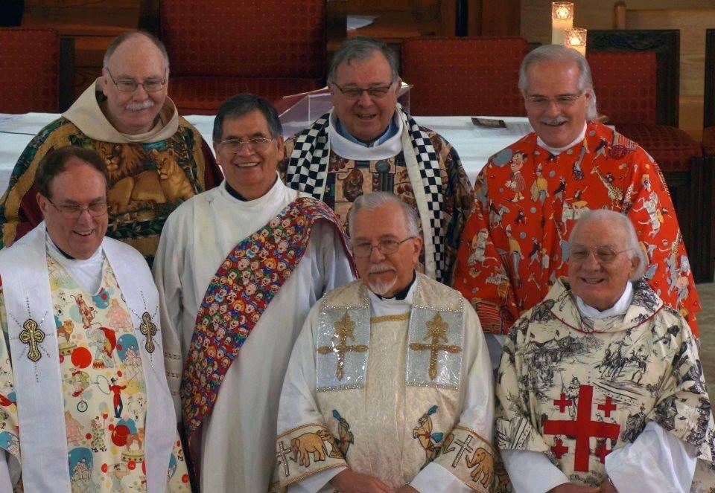
Luis Trevino
25 years, Deacon Luis Trevino has done just that, ministering to those who work behind the scenes at Arlington Park racetrack as walkers, groomers and trainers. Many are undocumented immigrants who follow the horse racing season, moving around the country from track to track
Luis Trevino
trevinoll@aol.com

Slide 12
Luis Trevino Full Bio
For 25 years, Deacon Luis Trevino has ministered to those who work behind the scenes at Arlington Park racetrack as walkers, groomers and trainers. Many are undocumented immigrants who follow the horse racing season, moving around the country from track to track.
immigrated to the United States from Monterrey, Mexico, when he was 17,
Ministers to other “people on the move” through the O’Hare Airport Chapel and as chaplain to circus and carnival workers who come through town
Connected to the U.S. Conference of Catholic Bishops’ outreach to “people on the move” and accompanied Auxiliary Bishop John Manz on a 2016 trip to Kentucky to visit migrant workers in the horse racing industry. Once a year for more than 15 years Bishop Manz has visited migrant workers around the country on behalf of the U.S. Conference of Catholic Bishops
Serves at the Church of the Holy Spirit in Schaumburg

